Slide 1
Definitions
Even Functions
Odd Functions
A function f(x) is called even if, for all values of x in the domain of the function, the following condition holds
f(−x)=f(x)
Example: f(x) = x^2
A function f(x) is called odd if, for all values of x in the domain of the function, the following condition holds
f(−x)= -f(x)
Example: f(x) = x^3

Slide 2
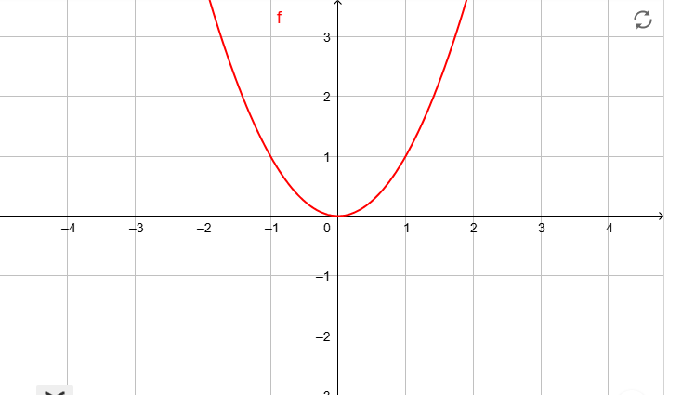
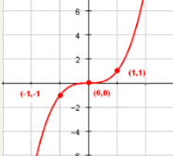
Graphical Representations
Even Functions
Odd Functions

Slide 3
Key Properties
Sum of Even Functions: The sum of two even functions is even.
Sum of Odd Functions: The sum of two odd functions is odd.
Sum of Even and Odd Functions: The sum of an even and an odd function is neither even nor odd in general.

